Slide 1



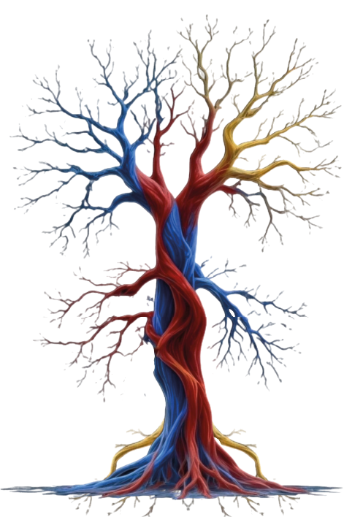

Name:
Orcid:
Adress::
Abstarct::

